Slide 1
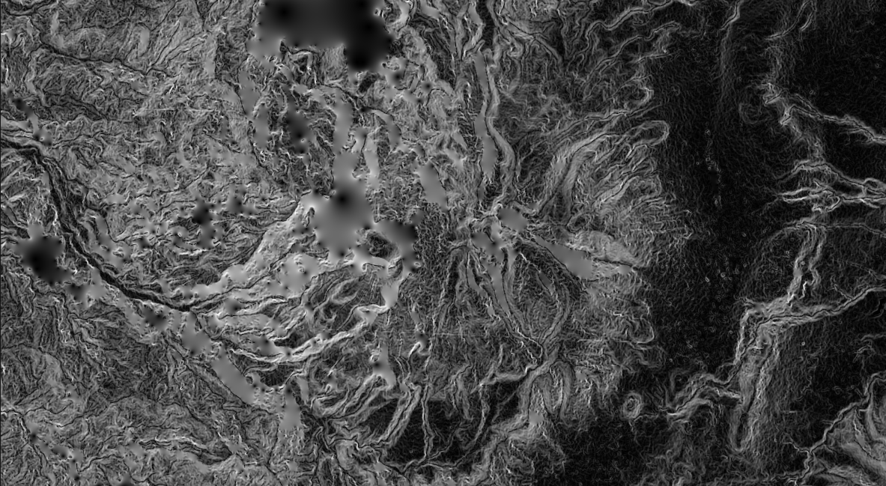
GIS for Geoscientists Session 3/4: Intermediate GIS
Presented by Nicholas Barber, 3rd Year PhD Student at the University of Cambridge, U.K.
ndb38@cam.ac.uk | www.volcannick.com | https://github.com/ndb38 | Twitter @volcannick

Slide 2
Finishing Up From Session 2: Corrections + Analysis
Corrections:
Need to discuss how to reproject layers
Review Georeferencer, Create Feature Steps
Finishing up analyses:
Summarize Population for each census block
Field Calculator
Creation of Hazard Zones
Dissolve
Statistics in a particular Hazard Zone
Statistics Viewer

Slide 3
Finishing Up From Session 2: Layout
Elements we want:
Main Map
Regional Inset Map
Legend
North Arrow
Scale bar
Grid
Labels for important features
Text box summarizing findings
Things to keep in mind:
Map Scale
Locking of display
Legend items
Grids and outlines

Slide 4
Course Structure
Today: Session 1 – Principles and Motivation for GIS in the Geosciences
Why GIS?
Principles of GIS
Getting acquainted with Quantum GIS
Tuesday November 10th: Session 2 – Beginner GIS Exercises
Tour of Interface
Guagua Pichincha Hazard Assessment
Friday November 13th: Session 3 – Intermediate GIS Exercises
Finishing up from last week
Importing raw data
Spatial Analysis
Interpolation
Data Management
Advanced formatting
Thursday November 17th: Advanced GIS Exercises (Work in Progress)
Geostatistics
Python
Models
Databases
Q&A

Slide 5
Let’s Get to It!
Section 2: Advanced Formatting
Line Symbology
Draw Effects
Heatmaps
Raster Viz.
3D Viewer
Section 3: Final Topics
Spatial Database Connections
Basics of Python
Further Learning
Section 1: Advanced Analysis
Exercise 2: Fluid Geochemistry of G.P.
Importing CSVs
Spatial Joins
Interpolating Point Shapefiles
Exercise 3: Landslide Risk near Quito
Raster Statistics
Rasterizing a Shapefile
Raster Calculator
Zonal Statistics

Slide 6
Outline of Today’s Activity
Exercise #2
We want to know the chemistry of the fluids measured at G.P. Are there hotspots of high SO4 activity?
Requires:
Importing known geochemical data.
Georeferencing 2 new maps
Importing a dataset with no lat/long information
Creating new features
Performing a spatial join
Interpolating to find hotpots
Exercise #3
Landslide Risk example
Importing precipitation data
Calculating Raster Slope
Rasterize rainfall
Use raster calculator

Slide 7
Session 3, Section 1
Handling Difficult Data Imports, Spatial Joins, Interpolating between Points, Raster Calculator, Spatial Statistics

Slide 8
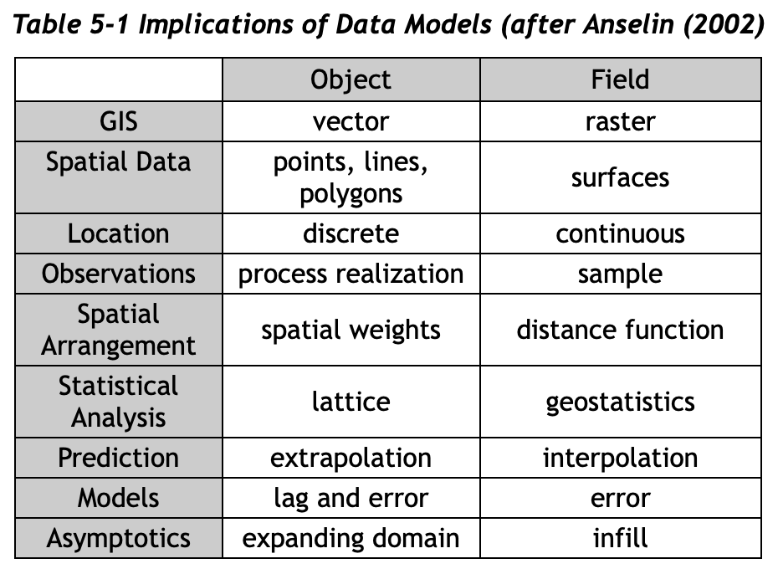
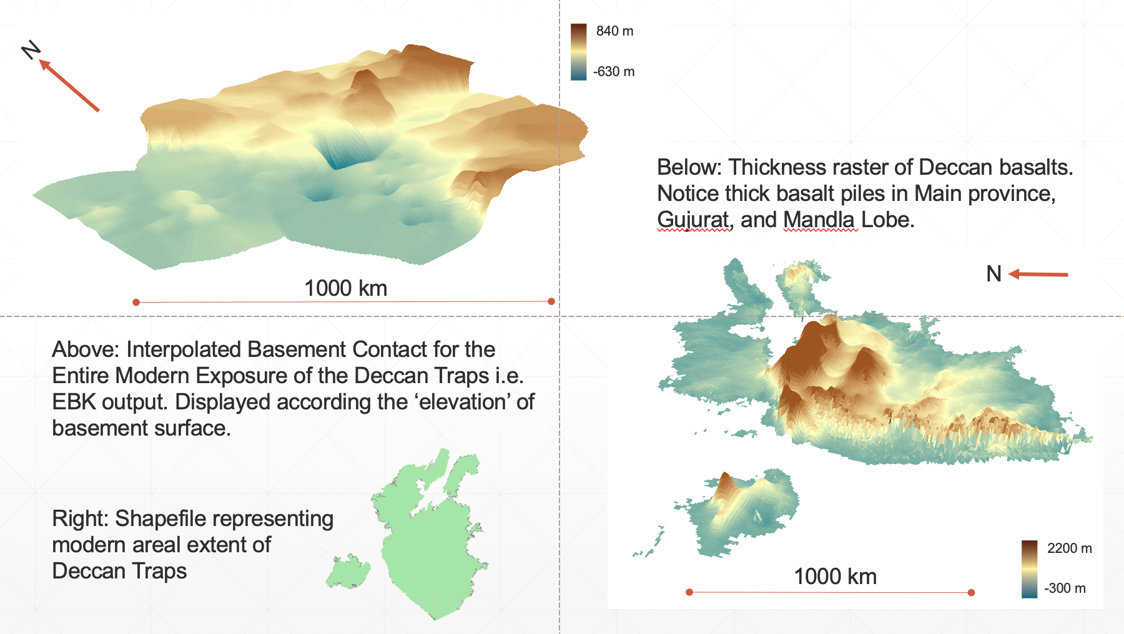
Geostatistics
Free AMAZING resource: https://www.spatialanalysisonline.com/HTML/index.html
One key feature of spatial statistics: because of spatial autocorrelation, data with a spatial dimension violate classical statistical assumption of independence
Independence – in probability theory, occurrence of event does not affect the probability of occurrence of another
Requires different approach to statistics and analysis
Special geostatistical operations: Inverse Distance Weighting (IDW), Kriging, Moran’s I coefficient
My Deccan work: Empirical Bayesian Kriging (EBK) >>>>

Slide 9
For next time…
Advanced Formatting
Model Builder
Python in QGIS
Further Learning

Slide 10
Section 2
Advanced Formatting

Slide 11
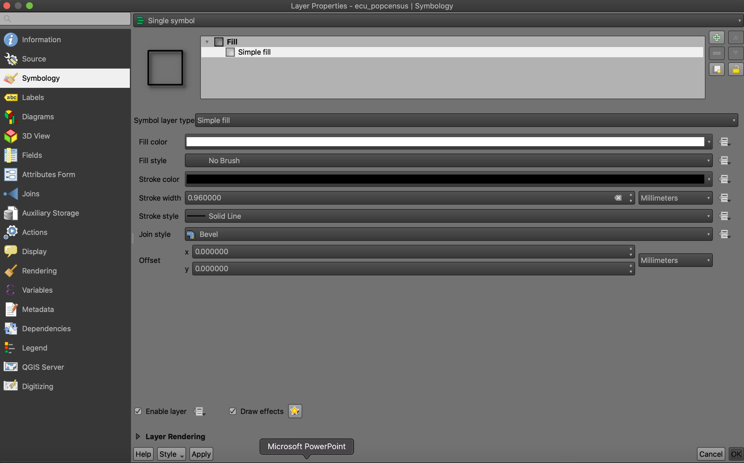
Symbology

Slide 12
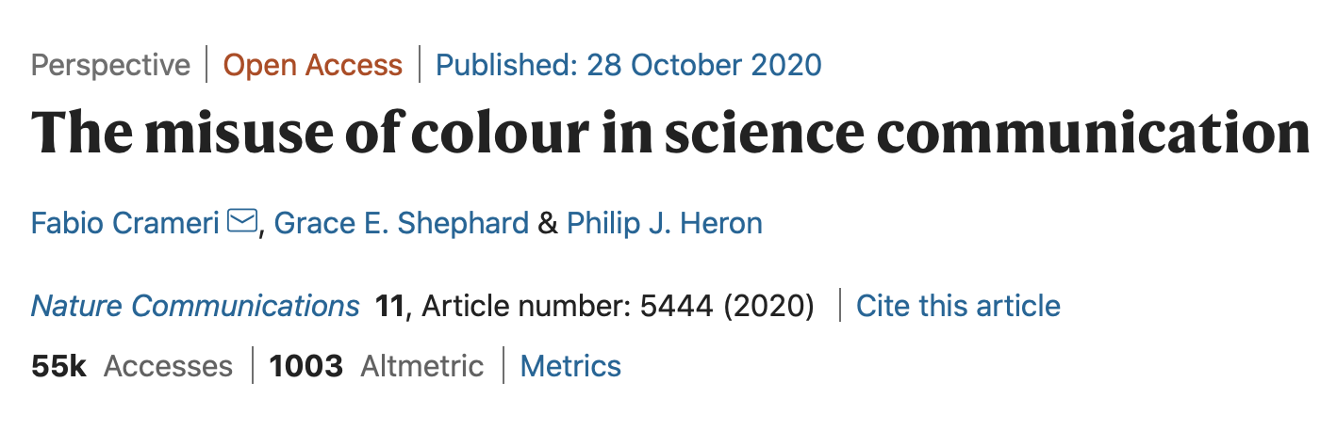
Symbology Advice
Design is an essential element of map making and GIS analysis
The appearance of your data affects how you and others perceive it (Crameri et al. 2020)
Experiment with symbology! When you submit your maps, I want to see different color scales, different polygon textures, different fonts.

Slide 13
Section 3: Databases + Python

Slide 14
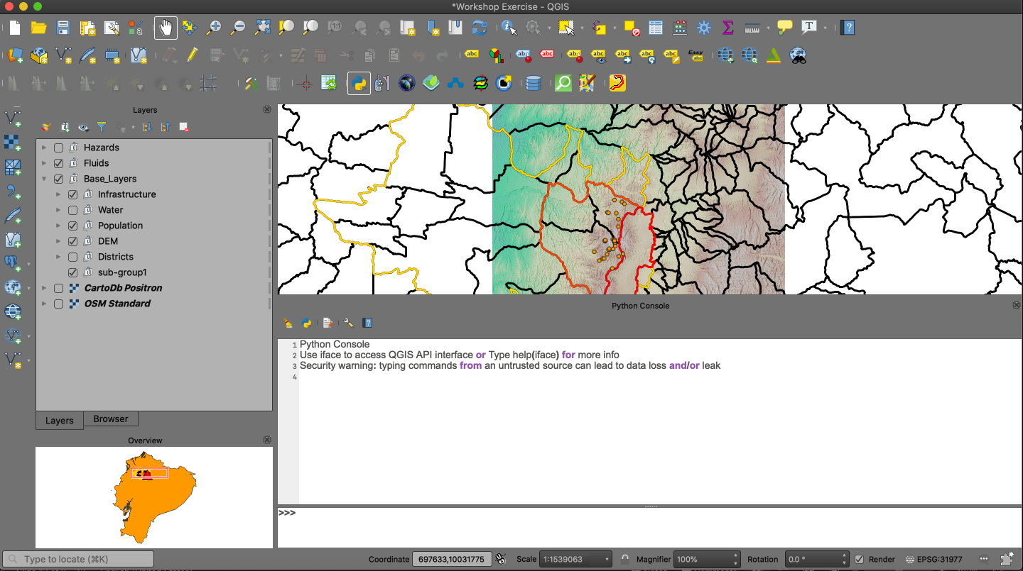

Slide 15
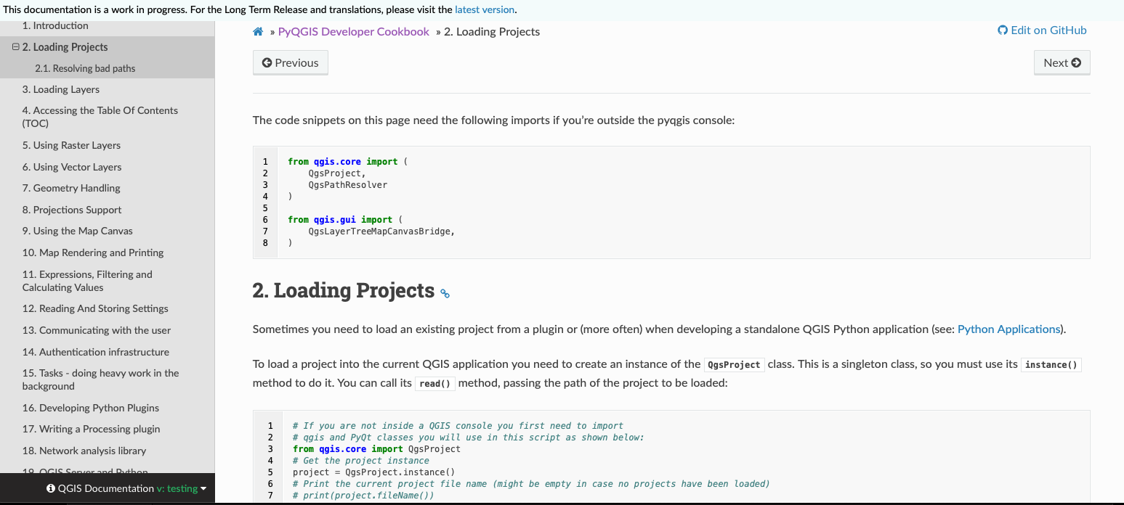
Python Walkthrough
Can use Python natively in QGIS
Integrates with outside apps like EarthExplorer
Uses own PyQGIS library with challenging, but accessible, syntax
https://docs.qgis.org/testing/en/docs/pyqgis_developer_cookbook/

Slide 16
Further Learning
We have only scratched the surface!
Best way to learn QGIS:
Find a project that you are interested in, and that requires QGIS
Use the forums: StackExchange, Documentation, GitHub
Take a break if you are feeling discuouraged
Seek out external learning opportunities
Borrow books from the library
Free resources online

Slide 17
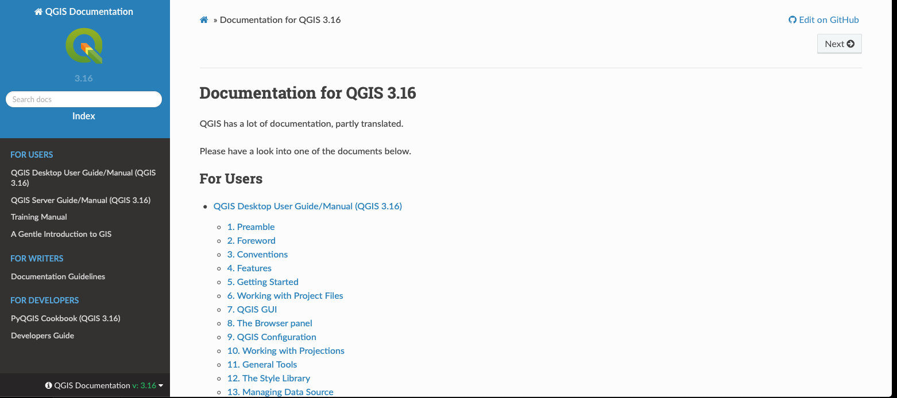

Slide 18
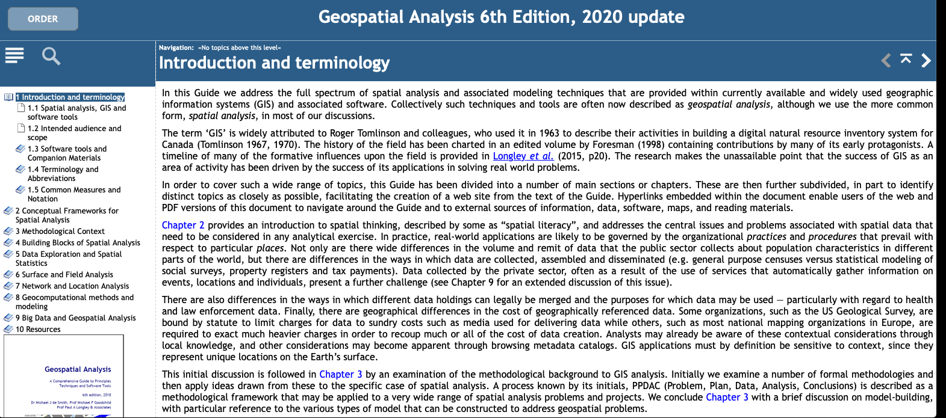

Slide 19
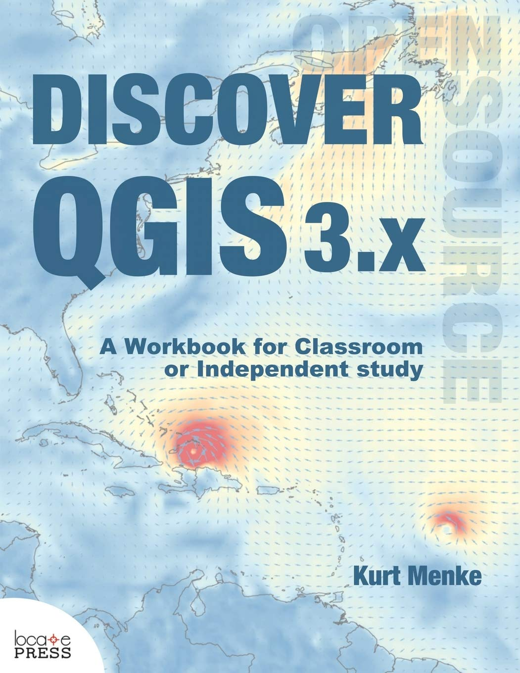

Slide 20


Slide 21


Slide 22
My goals at the start:
Highlight what GIS can do for geoscientists
Outline the key principles of a geographic information system
Providing a fully guided GIS workflow template
Identify key areas of growth for GIS in geoscience research

Slide 23
If you take nothing else away from this workshop….
GIS is a helpful tool in your workflow if you have data with a spatial dimension
GIS software lets you store, collect, analyze, and share spatial data
Modern GIS platforms like ArcMap and QGIS are all around workhorses – essential to tasks like spatial modeling, database management, cartography, geodesy, data visualization, hazard mitigation, and story telling
Learning the capabilities of GIS is acquired from repeated, often frustrating, trial and error with the hundreds of built-in tools
Studies should be designed with the GIS end user in mind!!!

Slide 24
Thank You ☺

